Slide 1
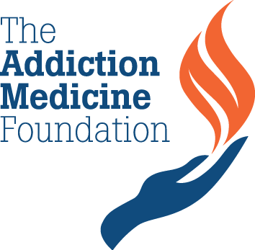
Addiction Medicine:
The Urgent Need for Trained Physicians
A Congressional Briefing Sponsored by
The Addiction Medicine Foundation
In cooperation with
The Congressional Prescription Drug Abuse Caucus
The Congressional Addiction, Treatment and Recovery Caucus
The Congressional Bipartisan Heroin Task Force
September 26, 2017

Slide 2

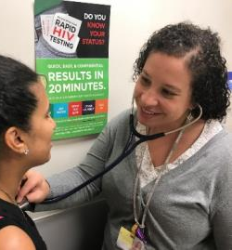
The House of Medicine
Addiction Medicine (ADM) Enters The House of Medicine
and U.S. Health Care
Addiction medicine recognized by the American Board of Medical Specialties
(ABMS) as a multi-specialty subspecialty of the American Board of Preventive Medicine March, 2016
Addiction medicine fellowships accepted for accreditation by The Accreditation Council for Graduate Medical Education (ACGME) June 2016
Expanding of the ADM Workforce…
Currently 3,500 ADM certified physicians, many part-time
By 2020, conservative estimate of need for 7,500 full time certified ADM physicians
To Improve Patient Care...
Integrated quality ADM prevention and treatment services
Accessible through physicians offices, clinics, hospitals, health systems, justice programs, schools and community organizations

Slide 3
Career Training
for Physicians
Exams
Fellows are trained as:
Expert clinicians who provide
quality care for patients and
consultation for other physicians;
Faculty who train medical and
other student health professionals and practicing health care providers who translate science to practice;
Researchers who seek to improve knowledge and practice; and
Change agents who educate the public, inform public policy and integrate evidence-based practices within health systems.
Maintenance of Certification
Annual
Exam
Fellowship
1-2 Years
Exam
Residency
3-4 Years
Exam
Medical School
4 Years

Slide 4
Community Service & Outreach
Education & Training
Clinics, Physician Offices, Hospitals
Outpatient and Residential Recovery Programs
VA, Mental Health, Juvenile and Criminal Justice Programs
Schools, Community Institutions/Organizations
Medical School
Residents
Primary Specialties
GME
Faculty + Leadership
Training the Trainers
Intra-disciplinary
Fellowship Training Drives Knowledge and Practice Across Medicine and Health Care
Addiction Medicine Fellowship Training Programs
Research
Promoting Science
& Practice
Basic Science
Prevention
Treatment
Disease Management
Community Health
Inter-disciplinary: Nursing, Pharmacology, Dentistry, Public Health, Psychology, Social Work
Public Policy
The General Public
Fellowship training programs form the core of Addiction Medicine Centers of Excellence – training ADM physicians and driving change across medicine and health care practice, building the science, increasing public understanding of unhealthy substance use and the disease of addiction, and informing public policy.

Slide 5
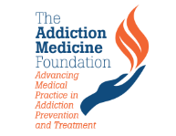
Addiction Medicine (ADM)
Fellowship Training Programs, 2017
Currently 45 Programs in U.S. Goal: 125 Funded Programs by 2025
AK
WA
NH
VT
ME
MT
ND
OR
MN
NY
ID
MA
WY
SD
MI
WI
RI
NE
IA
PA
CT
NV
OH
NJ
UT
IL
IN
DE
CO
WV
VA
MD
KS
MO
D.C.
CA
KY
TN
NC
AZ
NM
OK
AR
SC
MS
GA
AL
TX
LA
HI
FL
KEY
ADM Fellowship Training Programs
PR
NOTE: Star locations are not exact. For more information on precise location and capacity of ADM Fellowship Training Programs, see “The Addiction Medicine Foundation Fellowship Training Programs 9/26/2017.”

Slide 6
Addiction Medicine:
The Urgent Need for Trained Physicians
A Congressional Briefing Sponsored by
The Addiction Medicine Foundation
In cooperation with
The Congressional Prescription Drug Abuse Caucus
The Congressional Addiction, Treatment and Recovery Caucus
The Congressional Bipartisan Heroin Task Force
September 26, 2017

Slide 7
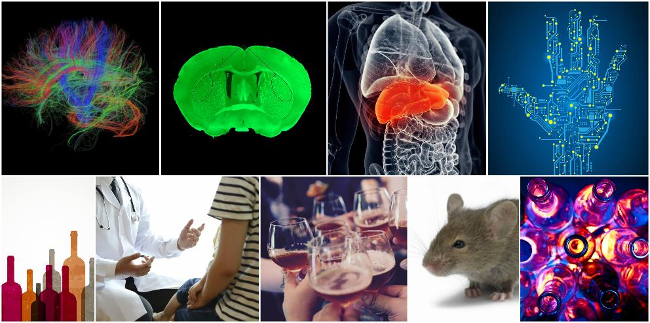


Addiction Medicine: The Urgent Need for Trained Physicians
George F. Koob, Ph.D.
Director
National Institute on Alcohol Abuse and Alcoholism
National Institutes of Health
September 26, 2017

Slide 8
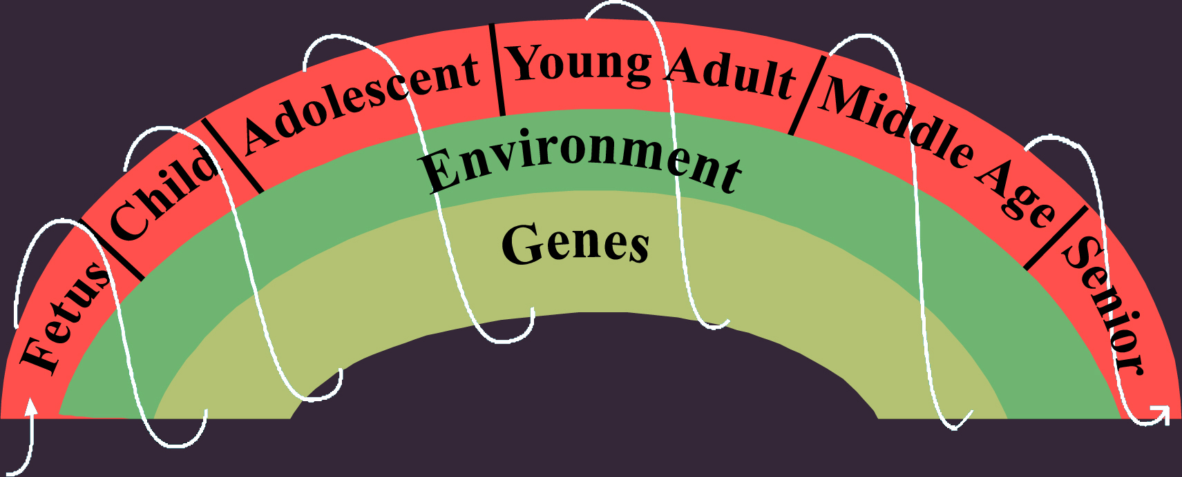
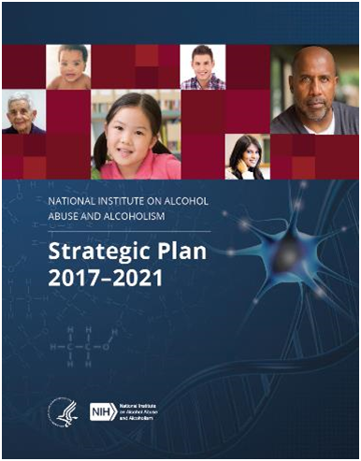
National Institute on Alcohol Abuse and Alcoholism
NIAAA is the largest funder of alcohol research in the world
Mission: Generate and disseminate fundamental knowledge about the effects of alcohol on health
and well-being, and apply that
knowledge to improve the diagnosis,
prevention, and treatment of alcohol-
related problems, including alcohol use
disorder (AUD) across the lifespan
2017-2021 Research Priorities:
  Identify mechanisms of alcohol action,
  alcohol-related pathology, and recovery
  Improve diagnosis and tracking of
  alcohol misuse, AUD, and alcohol-related consequences
  Prevent and treat alcohol misuse, AUD,
  co-occurring conditions, and alcohol-related
  consequences
  Enhance the public health impact of
  NIAAA-supported research
Alcohol

Slide 9
Cost and Scope of Alcohol-Related Problems
~88,000 people die annually from alcohol-related causes in the U.S.
3rd leading preventable cause of death in U.S.
~ 50% of U.S. liver disease deaths attributable to alcohol misuse
15.1 million adults have AUD
Increase in emergency department visits and hospitalizations related to alcohol in last 10 years
Sources: Prevalence – NSDUH (2015), NCI (2014), CDC (2016); Cost – CDC (2015), National Drug Intelligence Center - National Drug Threat Assessment (2011), 2014 Surgeon General’s Report, NHLBI (2012), Hutchinson et al. 2006.

Slide 10
Addiction is a Chronic Brain Disease
Decades of research shows that addiction is a chronic brain disease
Frequently co-occurs with other mental health conditions
Has many features in common with medical conditions such as diabetes, hypertension, and obesity
  Chronic
  Potential for recurrence and recovery
  Influenced by genetic, epigenetic, developmental, and environmental factors
  Requires a comprehensive approach to treatment
Notes:
SUD may increase risk of mental illness, mental illness may increase risk of SUD, or SUD and mental illness may stem from related causes

Slide 11
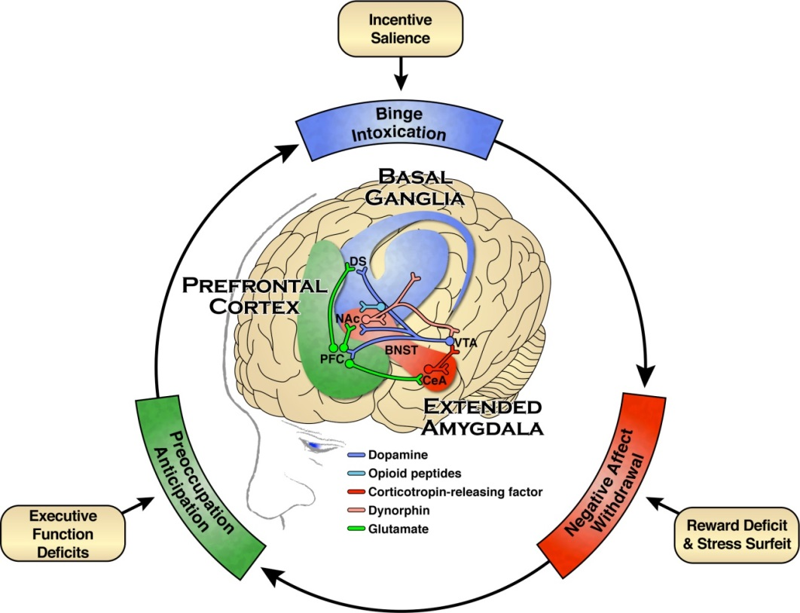
Neurobiology of Addiction
Notes:
Addiction involves a three-stage cycle—a loss of control over substance use (binge/intoxication stage), the experience of a negative emotional state in the absence of the substance (withdrawal/negative affect stage), and a compulsion to seek and take the substance (preoccupation/anticipation stage).
Worsens over time and involves progressive changes in the structure and function of the brain.

Slide 12



Preventing and Treating AUD
There are evidence-based interventions for preventing and treating AUD:
  Screening, Brief Intervention, and Referral to Treatment (SBIRT)
  Professionally-led behavioral interventions
  FDA-approved medications
  Mutual support groups, such as Alcoholics Anonymous
Notes:
The next several slides will focus on the first three, which are professionally-led interventions.

Slide 13
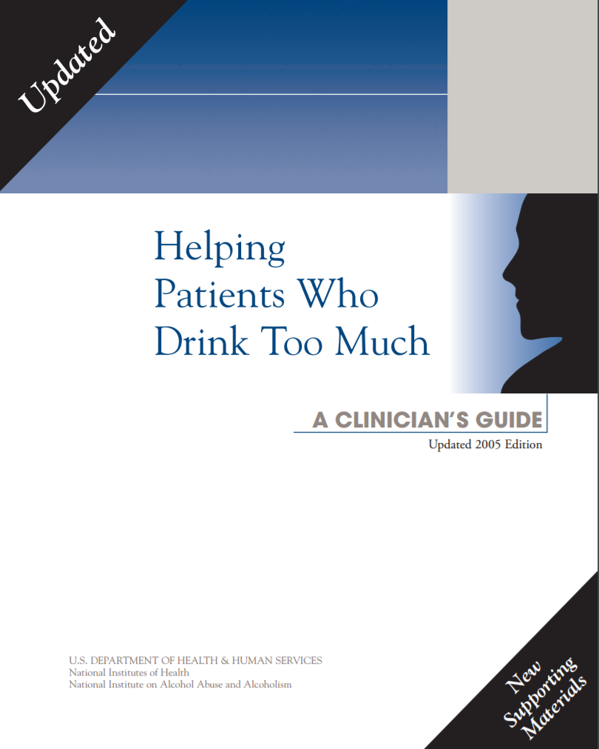
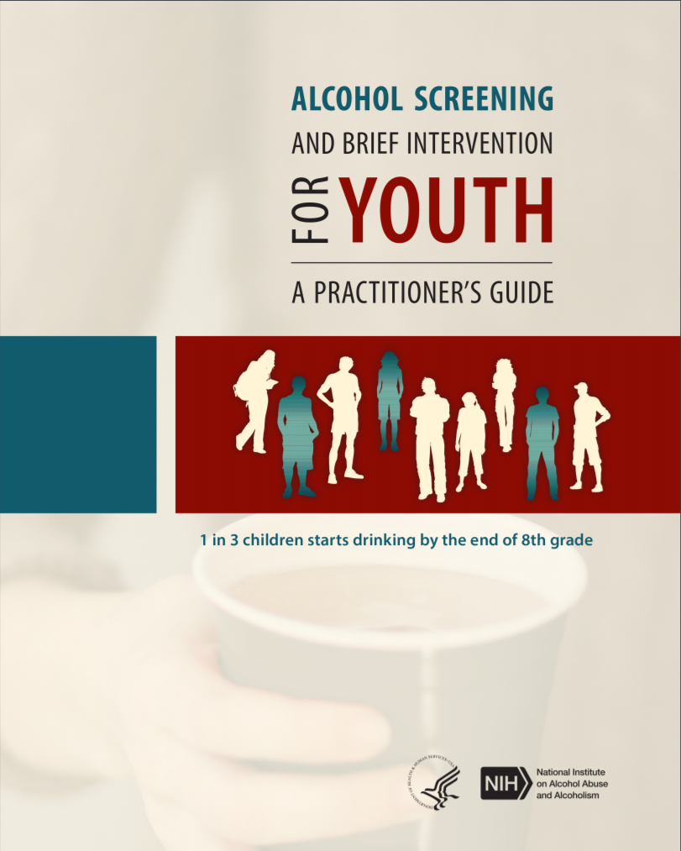
Alcohol Screening is an Effective Prevention Strategy
Alcohol screening in primary care reduces
alcohol misuse among adults; recommended
by U.S. Preventive Services Task Force
Mounting evidence that screening is effective
for preventing and reducing youth alcohol
misuse
One of the highest ranking preventive services
among 25 effective services (Solberg et al, 2008)
NIAAA developed “Helping Patients Who Drink
Too much: A Clinician's Guide” and a
2-question youth alcohol screener, “Alcohol
Screening and Brief Intervention for Youth,” to
help clinicians identify alcohol misuse in adults
and youth, respectively
Notes:
RSA 2017 slide

Slide 14
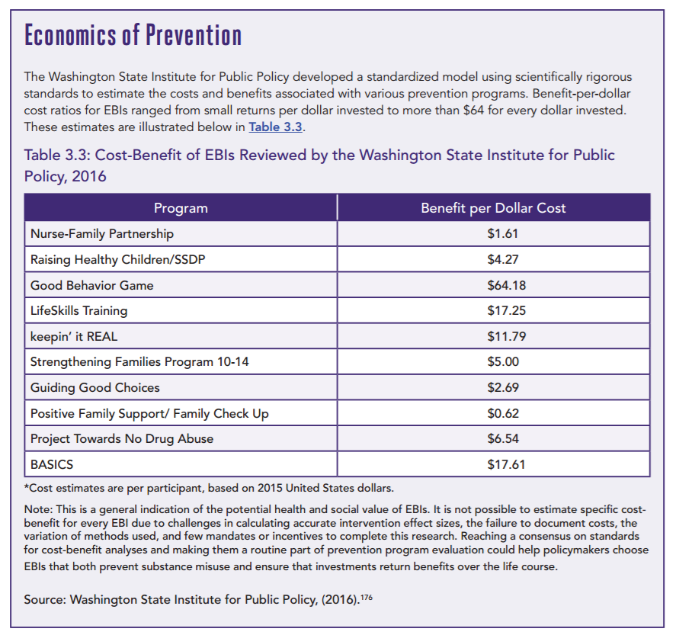
Prevention Saves Money
Notes:
BASICS is an example of a brief alcohol screening and intervention that saves money.

Slide 15

Effective Professionally-Led
Behavioral Interventions
Cognitive–Behavioral Therapy: to change the thought processes that lead to alcohol misuse and develop skills to cope with situations that trigger problem drinking
Motivational Enhancement Therapy: to enhance motivation to change drinking behavior by aligning changes in behavior with life goals
Community Reinforcement: to facilitate changes in a person’s life to make abstinence more rewarding than drinking
Marital and Family Counseling:
incorporates family into treatment to
help repair and improve family
relationships
Notes:
These behavioral interventions have consistently been found to reduce rates of heavy drinking. They share features, such as having health care professional work with people to set attainable alcohol reduction goals, build a strong social support system, and develop skills to cope with or avoid triggers that might contribute to relapse. They also differ in certain ways.
Cognitive–Behavioral Therapy: to change the thought processes that lead to alcohol misuse and develop skills to cope with situations that trigger problem drinking
Motivational Enhancement Therapy: to enhance motivation to change drinking behavior by aligning changes in behavior with life goals
Community Reinforcement: to facilitate changes in a person’s life to make abstinence more rewarding than drinking
Marital and Family Counseling: incorporates family into treatment to help repair and improve family relationships

Slide 16

Medication Therapies
Medications are often used in combination with behavioral interventions
Three FDA-approved medications for the treatment of AUD:
  Disulfiram (Antabuse®) blocks the breakdown (metabolism) of alcohol by the body, increasing acetaldehyde, and causing unpleasant symptoms such as nausea and flushing of the skin
  Naltrexone (oral: Revia® and injectable: Vivitrol®) diminishes the rewarding effects of alcohol to help people reduce heavy drinking
  Acamprosate (Campral®) reduces the negative emotional state associated with protracted abstinence from
  alcohol and may also reduce craving, making it
  easier to maintain abstinence

Slide 17

Alcohol Treatment Gap
<10% of people with AUD get any treatment
<4% of patients with AUD use an FDA-approved medication to treat their disorder
Individuals with AUD more often seek primary care for an alcohol related medical problem than AUD itself
NIAAA is developing a new product to help individuals find evidence-based treatment

Slide 18
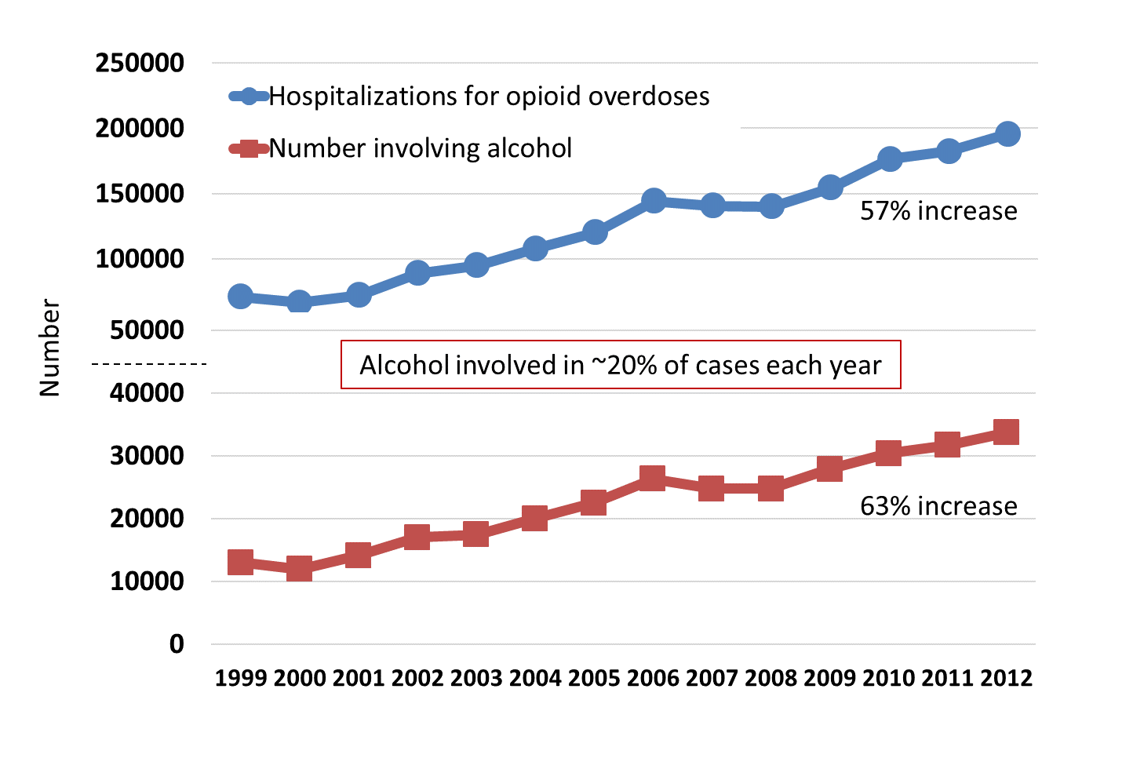
Hospitalizations for Opioid Overdoses with/without Alcohol
Source: Nationwide Inpatient Sample (NIS), unpublished

Slide 19

Growing the Addiction Medicine Workforce
Many providers do not perform screening, are not aware of evidence-based treatments or where to refer people
A study of 54 primary care clinics found 88% had no policies or requirements to ask patients about alcohol use, and
those with policies had no consistent evidence-based methods for screening or referral (Mertens et al., 2015)
Goal:
  Improve physician training in substance use prevention and treatment at all levels, from undergraduate and graduate medical education through residency, fellowship, and beyond
  Integrate prevention, early intervention, and
  treatment into routine medical care
Notes:
A recent CDC study found:
About 68% of patients report being asked about alcohol use, either by a health care professional or on a form, during their last check-up. However, few receive follow up questions/advice.
Among those who are asked about and report binge drinking, only 37% report being told about the risks and 18% report being advised to cut down.

Slide 20

Integrating Addiction Medicine into
Medical Education
NIAAA grant to SUNY Buffalo to “translate addiction into clinical practice” in collaboration with American Board of Addiction Medicine
  Paved the way for integrating addiction
  medicine into postgraduate medical
  education at 37 academic medical centers
  Provided model for residency training in
  addiction medicine
  Laid groundwork for recognizing addiction medicine as a subspecialty by American Board of Medical Specialties
NIAAA, NIDA, and other federal agencies engaged with White House on a national effort to grow the addiction medicine workforce
Next steps: Identify medical school curriculum needs and enhance addiction medicine questions on medical board exams
Notes:
RSA slide

Slide 21
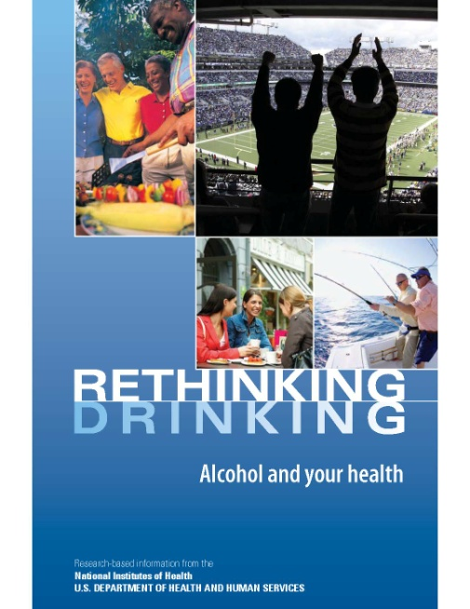
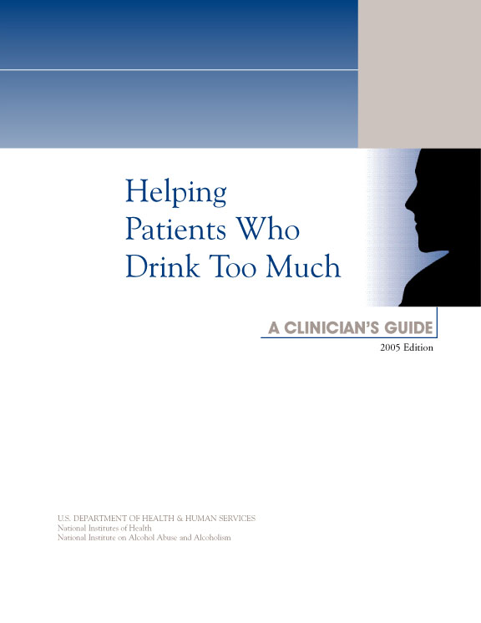
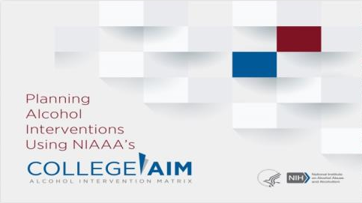
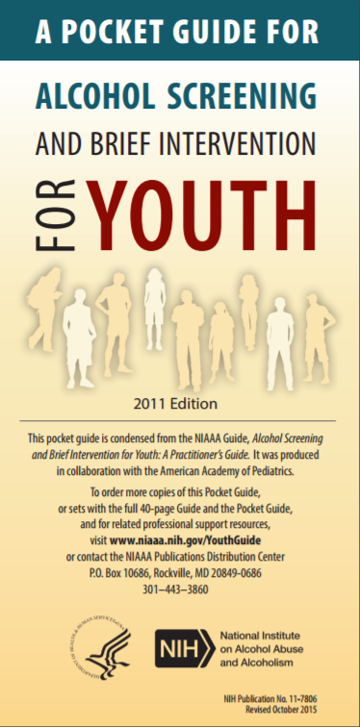
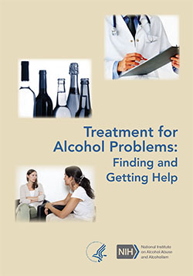
Thank You!
Special Thanks:
Jennifer A. Hobin
Peggy Murray
Kate Tepas
Aaron White
Bridget Williams-Simmons

Slide 22
Addiction Medicine:
The Urgent Need for Trained Physicians
A Congressional Briefing Sponsored by
The Addiction Medicine Foundation
In cooperation with
The Congressional Prescription Drug Abuse Caucus
The Congressional Addiction, Treatment and Recovery Caucus
The Congressional Bipartisan Heroin Task Force
September 26, 2017

Slide 23

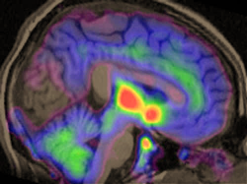
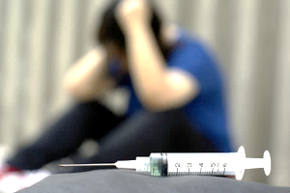
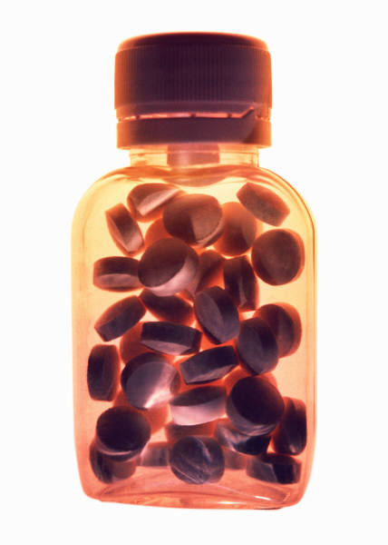

ADDICTION MEDICINE:
The Urgent Need for Trained Physicians
Nora D. Volkow, M.D.
Director
National Institute
on Drug Abuse
@NIDAnews

Slide 24
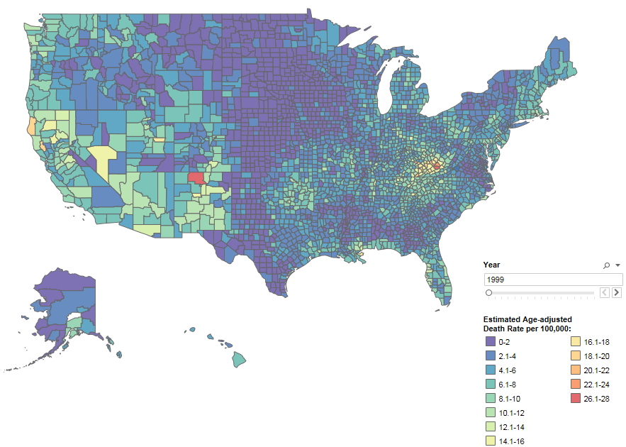
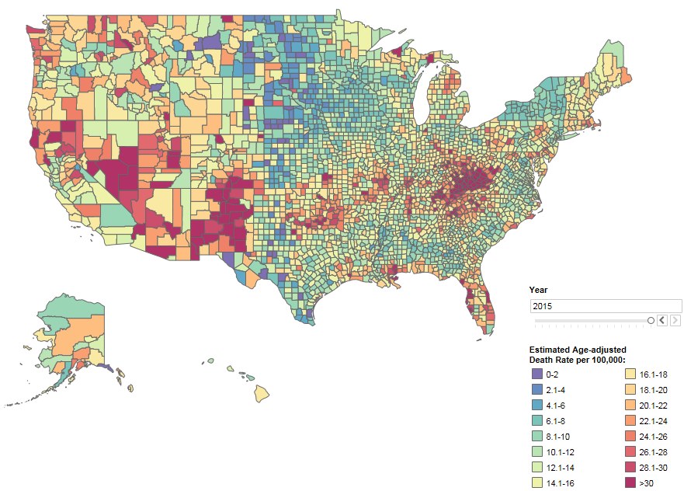
Overdose Death Rates
1999
2015
Designed by L. Rossen, B. Bastian & Y. Chong. SOURCE: CDC/NCHS, National Vital Statistics System

Slide 25
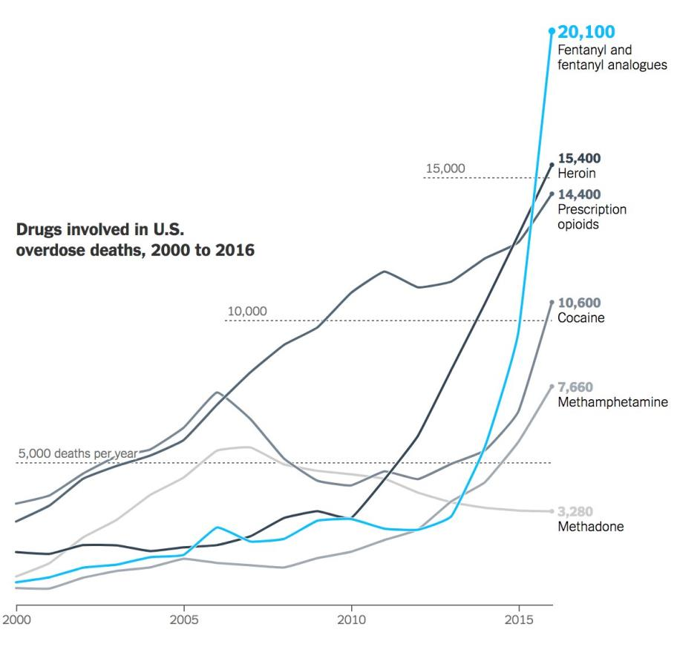
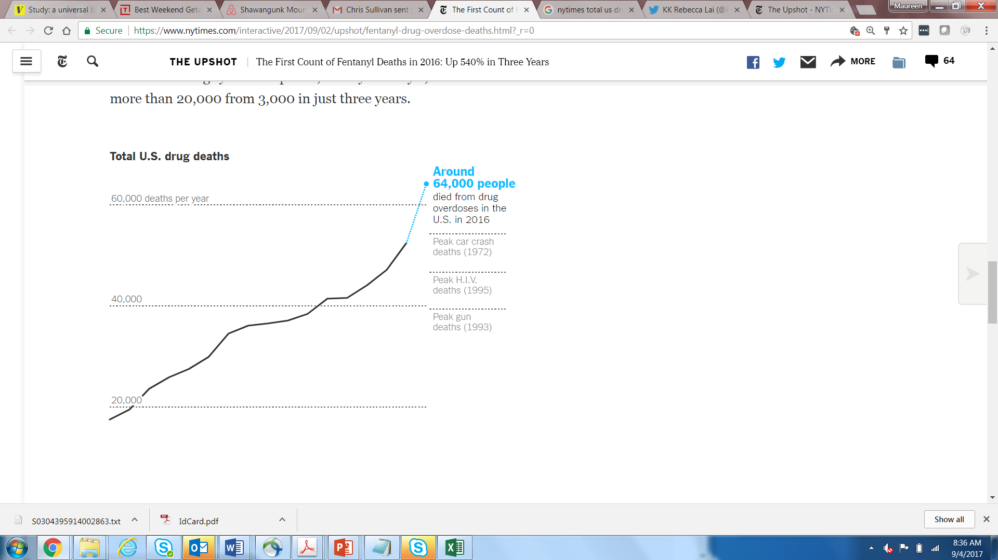
Opioid morphine milligram equivalents (MME) dispensed fell by over 15% from 2010-2015
Fentanyl-Related Deaths Surpassed Heroin or Rx Opioids in 2016
IMS Health, U.S. Outpatient Retail Setting
Estimate of Total U.S. Drug Deaths in 2016
Graphs from NY Times Article based on CDC MMWR Report 2017

Slide 26
Medication Assisted Treatment (MAT)
OUD Cascade of Care in USA
Full Agonist
(Methadone: Daily Dosing)
Opioid Effect
Current estimates
Treatment gap
90% goal
Partial Agonist
(Buprenorphine: 3-4X week)
Antagonist
(Naltrexone: ER 1 month)
Log Dose
DECREASES:
Opioid use
Opioid-related overdose deaths
Criminal activity
Infectious disease transmission
INCREASES
Social functioning
Retention in treatment
But MAT is highly underutilized!
Relapse rates are very high!
Williams AR, Nunes E, Olfson M. Health Affairs Blog, 2017

Slide 27
Improving Implementation of MAT
Knudsen et al., J Addict Med 2011.
2012 N-SSATS Data, SAMHSA

Slide 28
Integrating Buprenorphine Treatment Into
Federally Qualified Health Centers (FQHC):
Integrating BT in a large FQHC network increased retention rates to levels similar to those reported by clinical trials
PERCENT
6 mo.
12 mo.
Prescription of psychiatric medication and on-site substance abuse counseling improved retention whereas cocaine use decreased it
Haddad MS et al., DAD 2013 Jul 1;131(1-2):127-135.

Slide 29
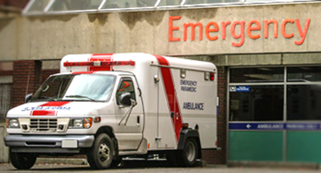
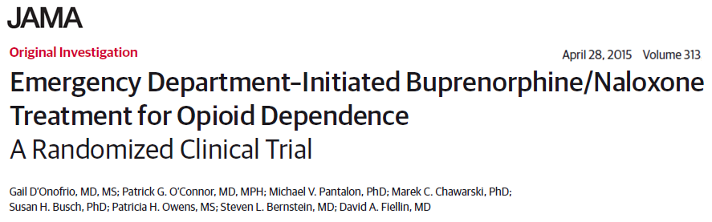
Improving Treatments for Addiction:
Implementing Medication-Assisted Treatment
Emergency department-initiated buprenorphine
  Reduced self-reported, illicit opioid use
  Increased engagement in addiction treatment; decreased use of inpatient addiction treatment services
Self-Reported Illicit Opioid Use in the Past 7 Days
Days

Slide 30
Improving Treatments for Addiction in Health Care Settings: Infectious Disease Clinics
Infectious Clinic’s-Based Buprenorphine of
Opioid-Dependent HIV+ Patients vs Tx Referral
Average Estimated Participation in
Opioid Agonist Therapy (%)
P<0.001
Lucas GM et al., Ann Intern Med 2010.

Slide 31
HIV Outcomes Among HIV-Infected, Opioid-Dependent Patients Receiving Buprenorphine within HIV Care Settings
Antiretroviral therapy initiation and viral suppression was significantly increased in subjects retained on buprenorphine for three or more quarters.
Altice, et al. J Acquir Immune Defic Syndr. 2011

Slide 32
Buprenorphine for the Treatment
of Neonatal Abstinence Syndrome
Duration of treatment (Panel A) and length of hospital stay (Panel B)
were shorter for buprenorphine group than ifor tmorphine group
Kraft WK et al., N Engl J Med 2017 May 4;376:2341-2348.

Slide 33
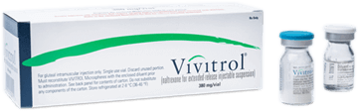

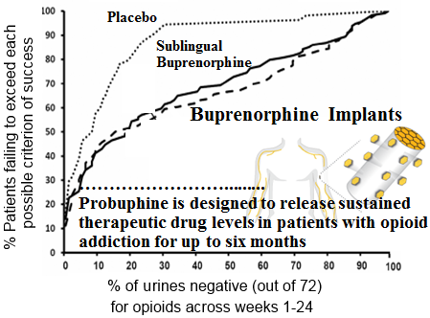
Extended Release Formulations
Vivitrol®
PROBUPHINE®
IM Injection q 4 weeks for 24 weeks
Median % Opioid-Negative Urines
Percent of Weekly Urine Tests
100%
80%
60%
40%
20%
0%
PLACEBO
XR-NTX
Placebo: N=124
XR-NTX: N=126
Rosenthal et al., Addiction 2013;105.
Krupitzky et al., Lancet 2011
  FDA approval – May 26, 2016
Opportunities for Partnership in the Development of Longer Acting Formulations and/or Drug Combinations to Improve Treatment Compliance and Retention

Slide 34


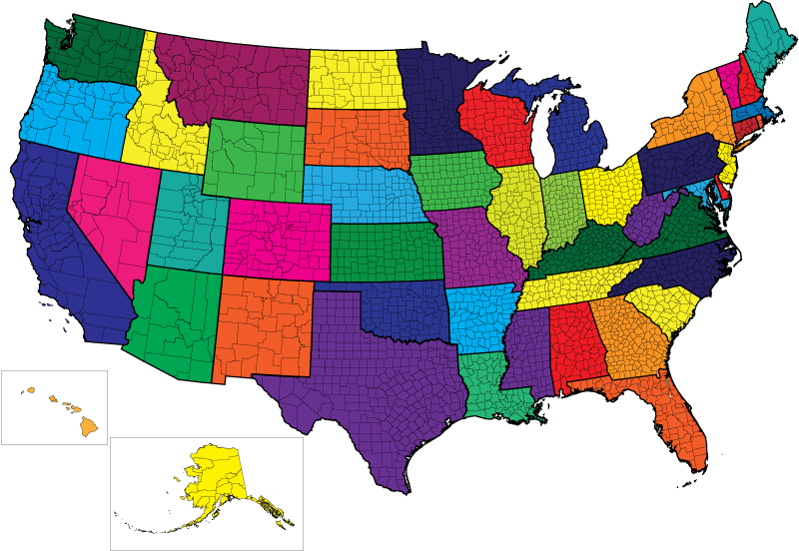


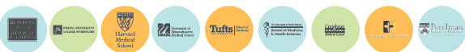
Education
PAIN
SUD
NIH Pain Consortium Centers
of Excellence in Pain Education
NIA
NINR
NICHD
NIAMS
NCCIH
ORWH
OBSSR
NIDA
NIDCR
NINDS
Goal:
Prevent SUD and improve outcomes in addiction through education of health care providers
Goal:
Improve pain treatment
through education

Slide 35
Addiction Medicine:
The Urgent Need for Trained Physicians
A Congressional Briefing Sponsored by
The Addiction Medicine Foundation
In cooperation with
The Congressional Prescription Drug Abuse Caucus
The Congressional Addiction, Treatment and Recovery Caucus
The Congressional Bipartisan Heroin Task Force
September 26, 2017

